Slide 1





Slide 2
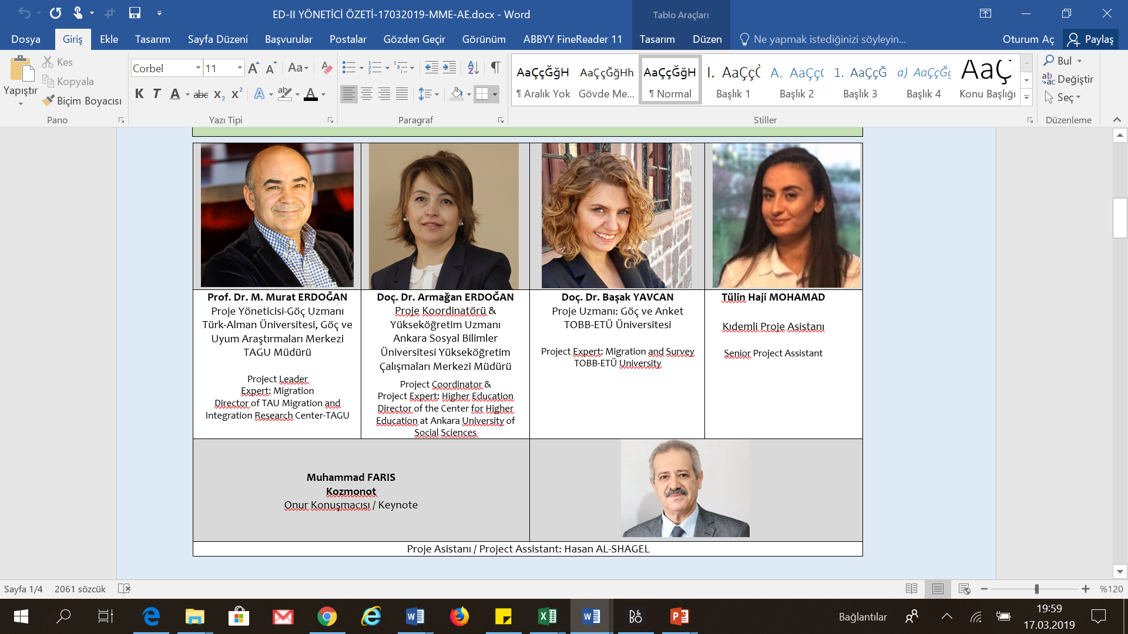
RESEARCH TEAM

Slide 3
1058 participants
740 fully completed survey
48 cities
490 participants
36 cities
ED II (2019)
ED I (2017)
15 months
8 months
4 thematic workshops with Syrian academics
REPORT
AND POLICY RECOMENDATIONS

Slide 4
Research Background
Higher Education is a strong tool for personal, social and economical empowerment and integration into the host country
ED I and II research aims
to analyse the conditions/needs and challenges of Syrian students and academics in Turkish higher education
to investigate the ways they can mediate between their community and Turkish society.
The main question of the research is
«how do the Syrian university students adapt to the Universities and integrate into society in Turkey?»

Slide 5
Global Setting

Slide 6
Syrian Crisis and Turkey: Key Facts
Turkey is hosting the largest numbers of refugees in the world since 2014
4.1 Million (3.6 million Syrians)
Rapid and large numbers of influx
58 thousand in 2011
4.1 million in 2019
Very young age
778.044 between 15-24 age group
1.234.000 between 5-17 age group
Education level is low (see table 1)
Birth rate is high
385.000 new born in Turkey since 2011
Legal status is «temporary protection»

Slide 7
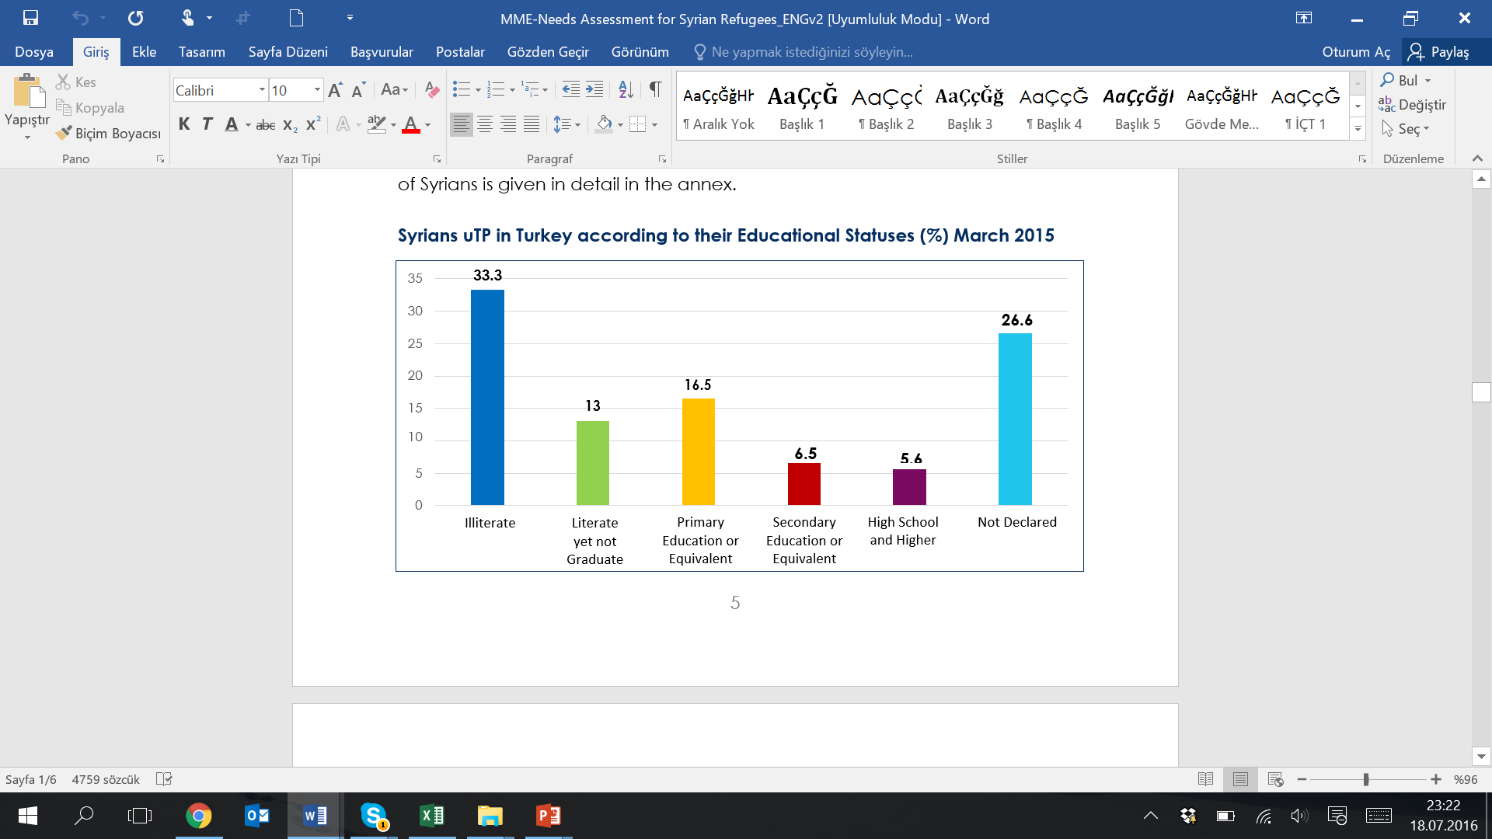

Slide 8
Turkish Higher Education System
CoHE is the responsible body to plan and supervise HE.
Number of students: 7.560.371 (2017-2018)
Access to HE:
Turkish citizens: highly competitive nationwide selection exam
2.381.412 students took the exam 857.240 (36 %) were placed (CoHE, 2019)
International students: individual HEIs according to guidelines and YÖS exam
Refugees: different tracks
Main challenges:
  Young population
  Supply-demand imbalance
  Only route for labour market
  Quantity-quality
  Open education is 50%
  High rate of unemployment in youth (25.5% in 15-24 age group)

Slide 9
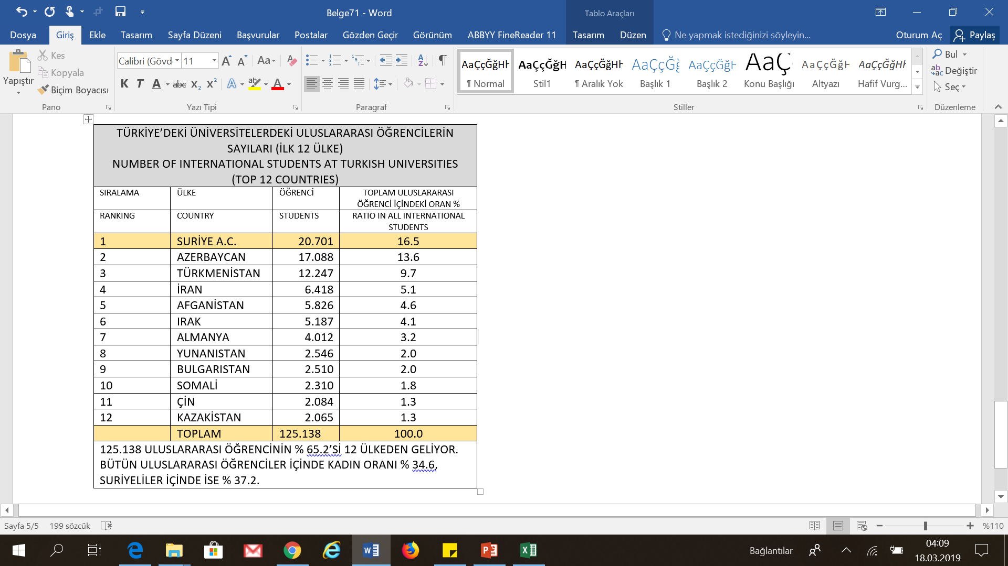

Slide 11
Outline of the Survey
Basic Demographics, educational background
Immigration Background: Support Network, Diaspora, Duration of Stay, Secondary Education
Satisfaction with different aspects of education in Turkey
Vulnerabilities: Trauma, Housing, Income
Livelihoods: Scholarships/Work
Economic Integration Attitudes/Future Prospects
Social Integration Attitudes: Prejudice, Social Distance, Institutional trust

Slide 12
Syrian Student Numbers in Universities
 |  |  | IL | ERKEK | KADIN | TOPLAM
1 | HARRAN ÜNİVERSİTESİ | DEVLET | ŞANLIURFA | 1468 | 1096 | 2564
2 | GAZİANTEP ÜNİVERSİTESİ | DEVLET | GAZİANTEP | 1041 | 846 | 1887
3 | KARABÜK ÜNİVERSİTESİ | DEVLET | KARABÜK | 1144 | 343 | 1487
4 | İSTANBUL ÜNİVERSİTESİ | DEVLET | İSTANBUL | 737 | 543 | 1280
5 | KAHRAMANMARAŞ SÜTÇÜ İMAM ÜNİVERSİTESİ | DEVLET | K.MARAŞ | 684 | 528 | 1212
6 | MERSİN ÜNİVERSİTESİ | DEVLET | MERSİN | 481 | 630 | 1111
7 | SİİRT ÜNİVERSİTESİ | DEVLET | SİİRT | 579 | 217 | 796
8 | MARDİN ARTUKLU ÜNİVERSİTESİ | DEVLET | MARDİN | 453 | 286 | 739
9 | ÇUKUROVA ÜNİVERSİTESİ | DEVLET | ADANA | 440 | 297 | 737
10 | FIRAT ÜNİVERSİTESİ | DEVLET | ELAZIĞ | 511 | 198 | 709
11 | ANADOLU ÜNİVERSİTESİ | DEVLET | ESKİŞEHİR | 460 | 239 | 699
12 | ALTINBAŞ ÜNİVERSİTESİ | VAKIF | İSTANBUL | 461 | 194 | 655
13 | BURSA ULUDAĞ ÜNİVERSİTESİ | DEVLET | BURSA | 350 | 250 | 600
14 | BAHÇEŞEHİR ÜNİVERSİTESİ | VAKIF | İSTANBUL | 344 | 154 | 498
15 | FIRAT ÜNİVERSİTESİ | DEVLET | ELAZIĞ | 511 | 198 | 709

Slide 13
Afgan Students in Turkish Universities (Total 6804)
 |  |  | İL | ERKEK | KADIN | TOPLAM
1 | KASTAMONU ÜNİVERSİTESİ | DEVLET | KASTAMONU | 435 | 52 | 487
2 | ANADOLU ÜNİVERSİTESİ | DEVLET | ESKİŞEHİR | 303 | 46 | 349
3 | İSTANBUL AYDIN ÜNİVERSİTESİ | VAKIF | İSTANBUL | 252 | 54 | 306
4 | ONDOKUZ MAYIS ÜNİVERSİTESİ | DEVLET | SAMSUN | 203 | 44 | 247
5 | BURSA ULUDAĞ ÜNİVERSİTESİ | DEVLET | BURSA | 196 | 48 | 244
6 | SAKARYA ÜNİVERSİTESİ | DEVLET | SAKARYA | 184 | 38 | 222
7 | ERCİYES ÜNİVERSİTESİ | DEVLET | KAYSERİ | 123 | 38 | 161
8 | KARABÜK ÜNİVERSİTESİ | DEVLET | KARABÜK | 115 | 37 | 152
9 | İSTANBUL ÜNİVERSİTESİ | DEVLET | İSTANBUL | 120 | 29 | 149
10 | NECMETTİN ERBAKAN ÜNİVERSİTESİ | DEVLET | KONYA | 122 | 21 | 143
11 | KOCAELİ ÜNİVERSİTESİ | DEVLET | KOCAELİ | 125 | 15 | 140
12 | ANKARA YILDIRIM BEYAZIT ÜNİVERSİTESİ | DEVLET | ANKARA | 99 | 35 | 134
13 | SELÇUK ÜNİVERSİTESİ | DEVLET | KONYA | 95 | 33 | 128
14 | ESKİŞEHİR OSMANGAZİ ÜNİVERSİTESİ | DEVLET | ESKİŞEHİR | 86 | 25 | 111
15 | KARADENİZ TEKNİK ÜNİVERSİTESİ | DEVLET | TRABZON | 93 | 17 | 110

Slide 14
YTB SCHOLARSHIP FOR SYRIAN STUDENTS
Type of Degree | TURKEY Sc | DAFI | EU (HESP) | HOPES
TOTAL | 2704 | 553 | 248 | 45
Associate's Degree (AA) | 56 | 18 |  | 6
Bachelor's Degree (BA) | 2278 | 535 | 139 | 39
Master’s Degree | 144 |  | 109
Doctorate | 226

Slide 15
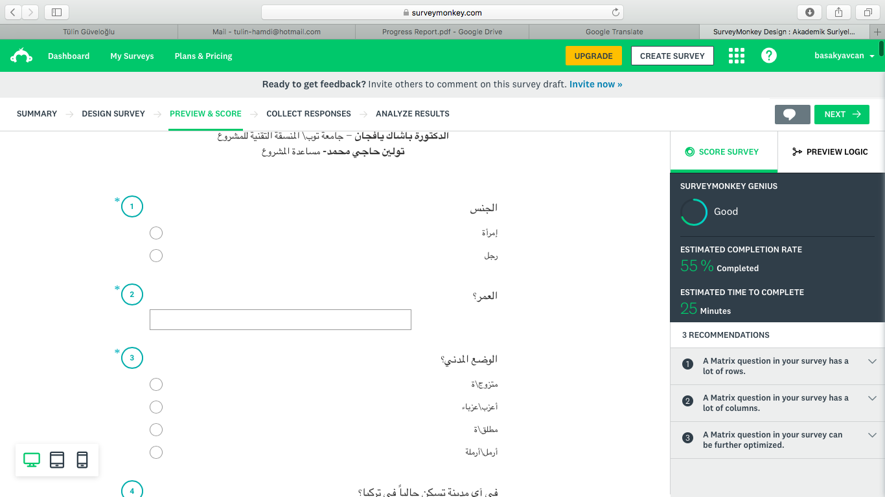
ANKET ÇALIŞMASI
CONDUCTED SURVEY
1.045 KATILIMCI / PARTICIPANTS
TEMSİLİ ÖRNEKLEM / BALANCED SAMPLE
GÜNCEL VERİLER / UP-TO-DATE INFORMATION
KAPSAMLI ÇERÇEVE / COMPREHENSIVE APPROACH
İÇERĞİN ANLAŞILMASI / UNDERSTANDING THE CONTEXT
BULGULAR VE ANALİZLER / VE FINDINGS AND ANALYSIS

Slide 16
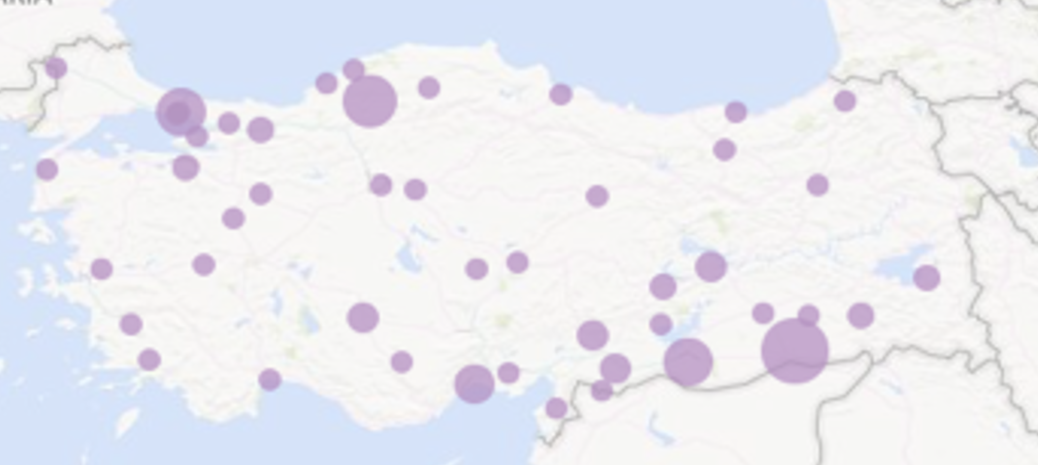
ED-II ANKETİNİN UYGULANDIĞI İLLER / DISTRICTS COVERED BY ED-II SURVEY

Slide 17
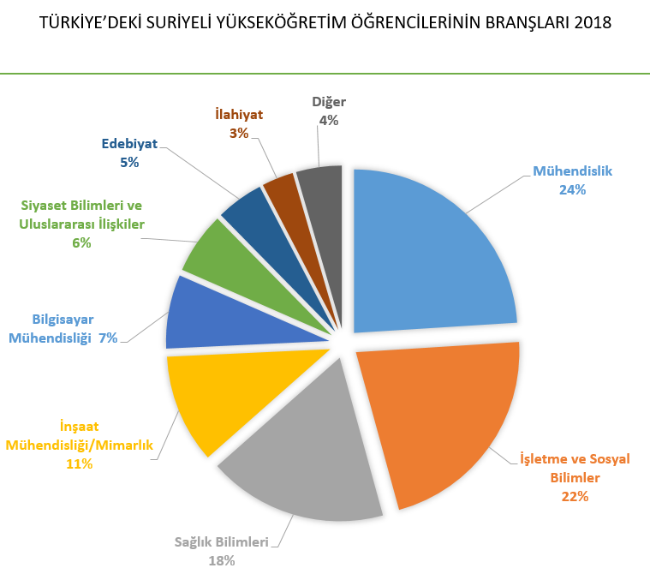
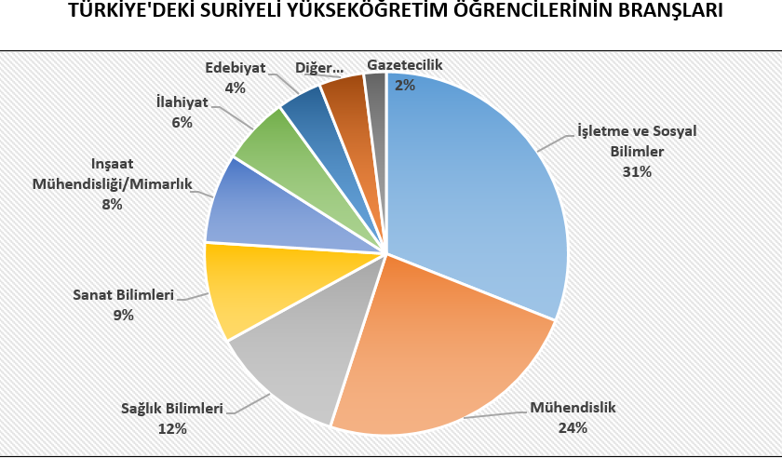
ED-II (2019)
ED-I (2017)

Slide 18
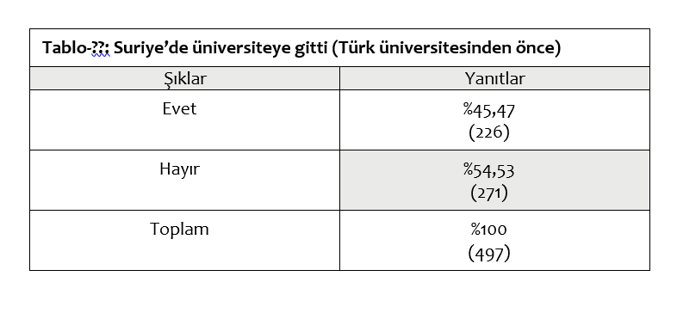
DID YOU GO TO COLLEGE IN SYRIA?
SEÇENEKLER | KATILIMCI SAYISI | %
YES | 507 | 47.92%
NO | 551 | 52.08%
TOTAL | 1,058

Slide 19
HOW DO YOU COMPARE EDUCATION IN TURKEY WITH SYRIA?
Options | Number of Respondents | Percentage
A lot better | 79 | 22.77%
Better | 175 | 50.43%
Same | 69 | 19.88%
Worse | 21 | 6.05%
A lot worse | 3 | 0.86%
Total

Slide 20
Difficulties Experienced at the Time of Registration
Category | ED II | ED I
None/ No problems | 20.85% | 19.00%
I could not access information on universities and programs | 10.29% | 14.25%
I had difficulty in paying for the expenses related to higher education | 28.74% | 24.80%
I had difficulty preparing application and registration documents | 14.43% | 15.04%
I had difficulty because of the language problem | 18.85% | 11.61%
Other | 10.82% | 15.30%

Slide 21
PATH TO COLLEGE | NUMBER OF RESPONDENTS | %
Direct Transfer from my HE Institution in Syria | 92 | 12.43%
Applied to the University Quota | 391 | 53.11%
Took the YÖS Exam | 211 | 28.65%
Entered as a Special Student | 34 | 4.59%
Other | 47 | 15.41%
Total | 740

Slide 24
Options | Number of Respondents | Percentage
All by myself | 317 | 52.05%
w/ Support of Syrian Friends | 199 | 32.68%
w/ Support of Turkish Friends | 53 | 8.70%
w/ Support from my Academic Advisor | 17 | 2.79%
w/ Support of other Professor | 12 | 1.97%
w/ Support of Admin Staff | 11 | 1.81%
Total | 609

Slide 26
Have you heard of Scholarships for Syrian Students?
 | Number | Percentage %
Never heard of these scholarships and never applied for them | 80 | 10.70%
I’ve heard of these scholarships but haven’t applied | 101 | 13.52%
I’ve applied to these scholarships bu didn’t get them | 433 | 57.96%
I have applied to these scholarships and still awaiting response | 52 | 6.96%
I have applied to these scholarships and currently benefiting from them | 78 | 10.44%

Slide 28
EXPERIENCES | NUMBER OF RESPONDENTS | PERCENTAGE %
Fear | 470 | 62.09%
Loss of a known person | 358 | 47.29%
Loss of a friend | 396 | 52.31%
Loss of a relative | 404 | 53.37%
Education Interruption | 533 | 70.41%
Rapid Impoverishment | 549 | 72.52%
Haivng to work | 367 | 48.48%
Forced relocation | 585 | 77.28%
Dissolvement of family | 438 | 57.86%
Permanent physical disability | 38 | 5.02%
Direct psychological trauma | 476 | 62.88%

Slide 30
ÖNÜMÜZDEKİ BEŞ YIL İÇİNDE NASIL OLACAĞINI BEKLEDİĞİNİZİ BELİRTİNİZ
ÜNİVERSİTELİLERİN GELECEK BEKLENTİLERİ OLDUKÇA İYİMSER. EN KARAMSAR OLUNAN ALAN SURİYE’YE YÖNELİK. SURİYE’DEKİ SİYASİ DURUMUN DAHA İYİYE GİDECEĞİNİ BEKLEYENLERİN ORANI SADECE % 18 İKEN KÖTÜLEŞECEĞİNİ DÜŞÜNENLERİN ORANI % 61)

Slide 32
.
Options | NUMBER OF RESPONDENTS | %
Not at all interested in resettlement | 310 | 44.67%
I would go in an instant if i have an opportunity | 89 | 12.82%
I would go if i cannot finish my studies in Turkey | 72 | 10.37%
I would go if i cannot find a job in turkey upon graduation | 187 | 26.95%
If i have a relative over there who can help me out | 36 | 5.19 %

Slide 33
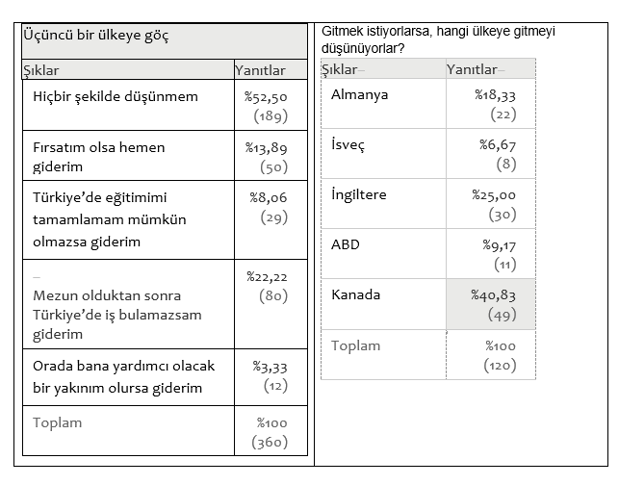
RESETTLEMENT COUNTRY PREFERENCE
COUNTRY OPTIONS | NUMBER
CANADA | 112 | 36 %
GERMANY | 44 | 14 %
SWEDEN | 19 | 6 %
UK | 45 | 15 %
USA | 38 | 12 %
GULF STATES | 55 | 18 %
OTHERS | 31 | 10 %

Slide 34
APPLIED FOR TURKISH CITIZENSHIP?
 | NUMBER OF RESPONDENTS | %
RECEIVED CITIZENSHIP | 59 | 14.08%
IN THE PROCESS | 72 | 17.18%
NEVER BEEN CALLED | 288 | 68.74%

Slide 35
Türkiye Cumhuriyeti’ndeki statünüz ile ilgili aşağıdaki konularda ne derece isteklisiniz?
(Suriyeli öğrencilerin en çok arzu ettikleri statü Türk ve Suriye vatandaşlıklarına aynı anda sahip olmak (% 92+))

Slide 36
SOSYAL MESAFE:
Yerli halktan birileri ile çeşitli ilişkilerde bulunmak konusundaki görüşleriniz nelerdir?

